Slide 1
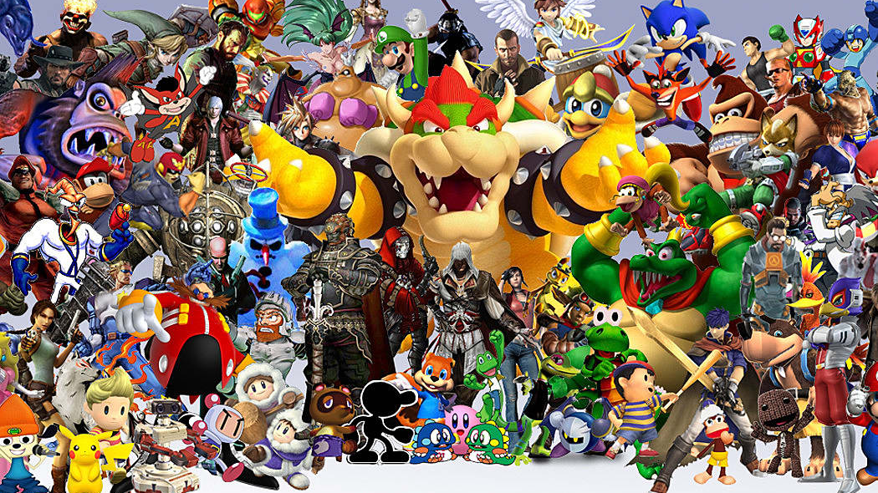
Game Presentation
By Émilie Mayodon and Akash Singh

Slide 2
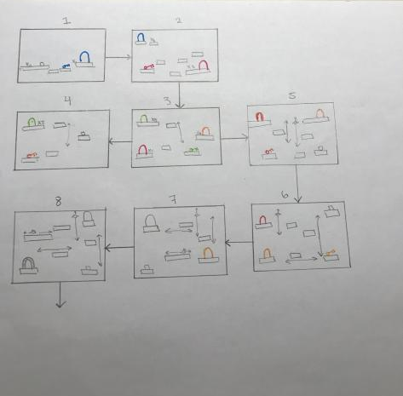
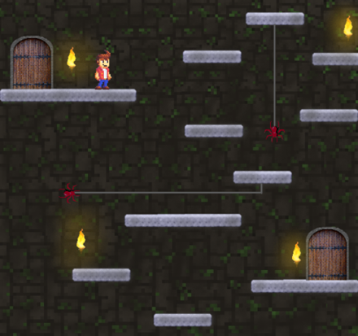
Executive Summary and Level Design
The setting in the game is taking place in an underground dungeon under a castle in Scotland, where the crypt has brick walls and the platforms are made of concrete.
This game lets you jump, pick up keys, and open doors while avoiding moving enemies. There are moving platforms, horizontally and vertically, increasing the difficulty over time.
The player has three lives to begin with, and there are no way to gain them back. The game ends either by losing all your lives or by directly falling into a pit.

Slide 3
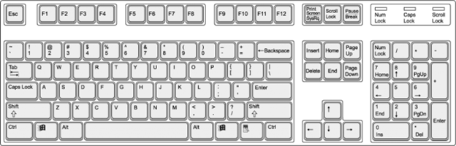
Controls
Move to the left
Move to the right
Interact with items
Jump

Slide 4
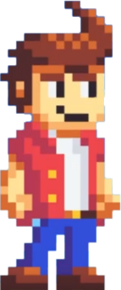
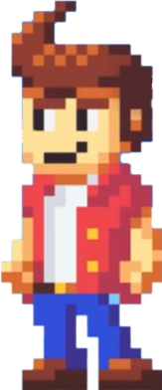
Individual Tasks
Implement core mechanics (jumping, picking up items, moving)
Enemies (spiders, rats, pits)
Moving platforms (horizontal and vertical)
Backgrounds (images, prop images)
Transitions (doors and keys mechanic)
Hearts (three lives)
Music (soundtrack, sound effects)
Game Character (Flynn)

Slide 5


Slide 6
Learnings
Right:
Same page for the game direction
Slowly solve all the problems
Wrong:
Github always had conflicting files, had to create many branches
Could not merge properly
Greenfoot made our PCs slower and kept crashing

